Slide 1

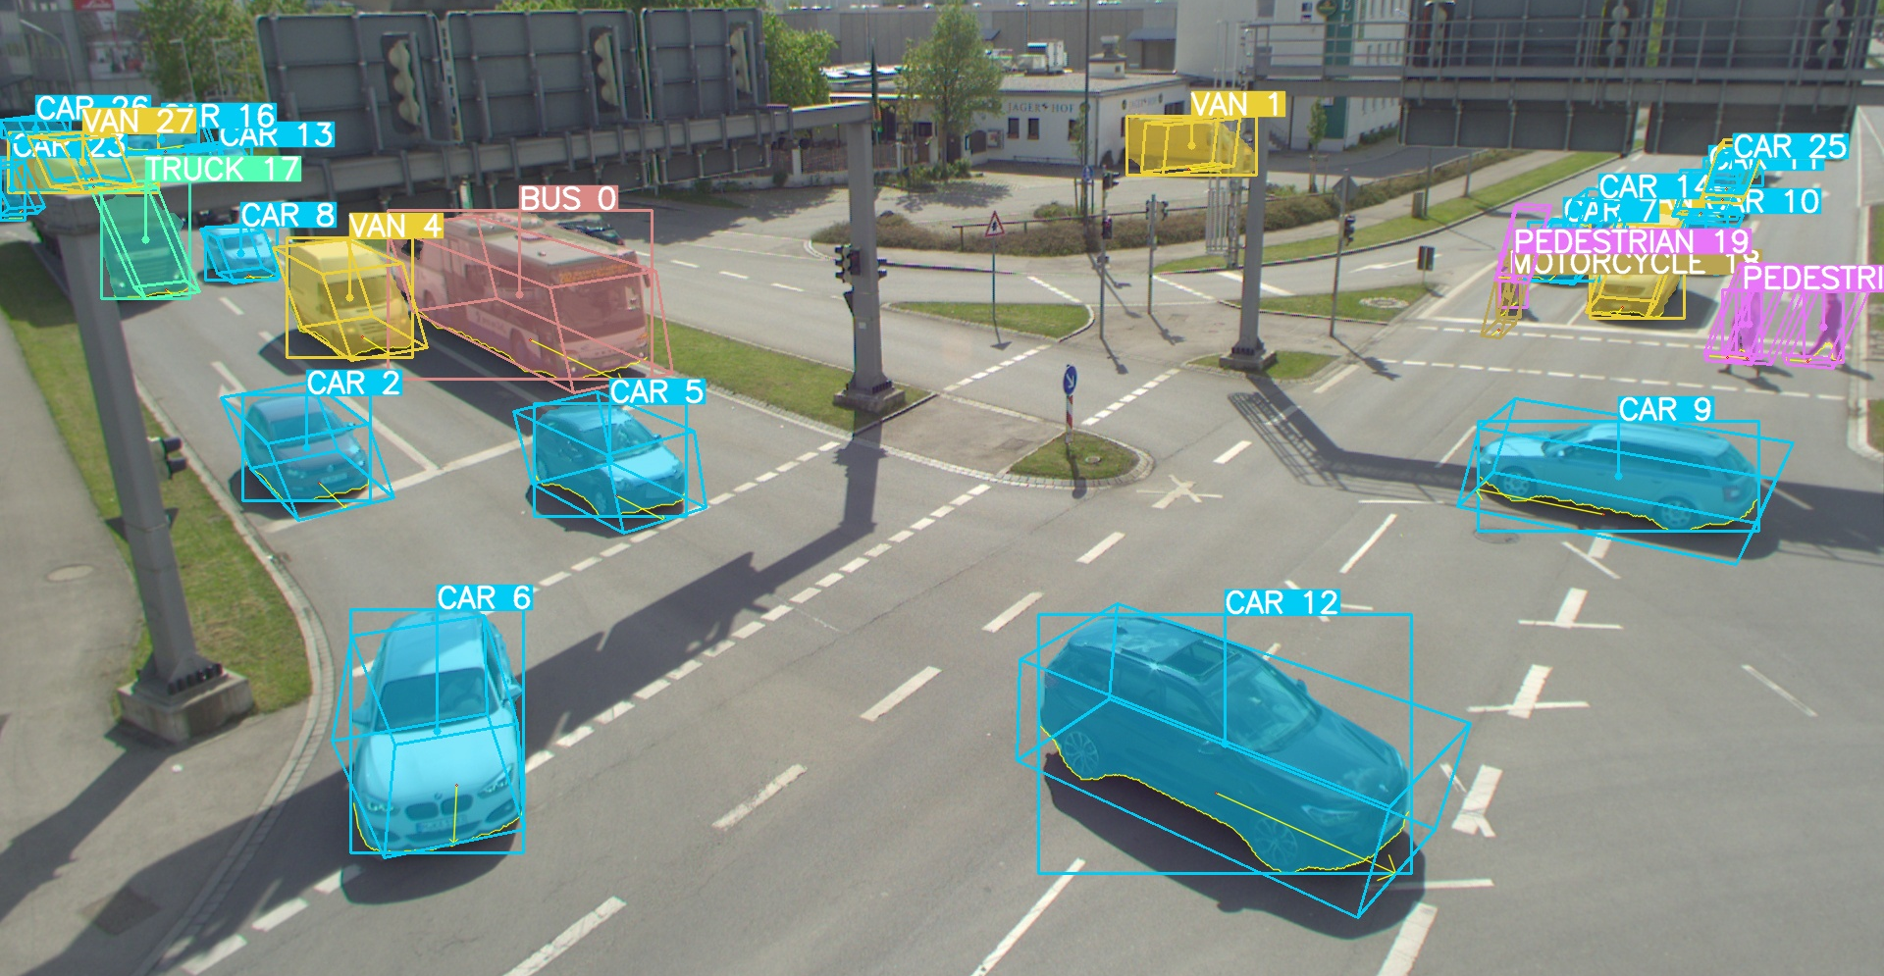
Bachelor’s Thesis Presentation
Monocular Roadside 3D Perception based on Instance Segmentation
Bach Ngoc Doan
Chair of Artificial Intelligence and Robotics (AIR)
Department of Computer Engineering (CE)
School of Computation, Information and Technology (CIT)
Technical University of Munich (TUM)
I6 Robotics Lab
Schleißheimer Straße 90A
85748 Garching-Hochbrück
February 23, 2024
Notes:
Welcome …

Slide 2






Content
Introduction
Related Work
Solution Approach
Training and Evaluation
Conclusion
Future Work
23.02.2024 Monocular Roadside 3D Perception based on Instance Segmentation Bach Ngoc Doan
Notes:
2

Slide 3
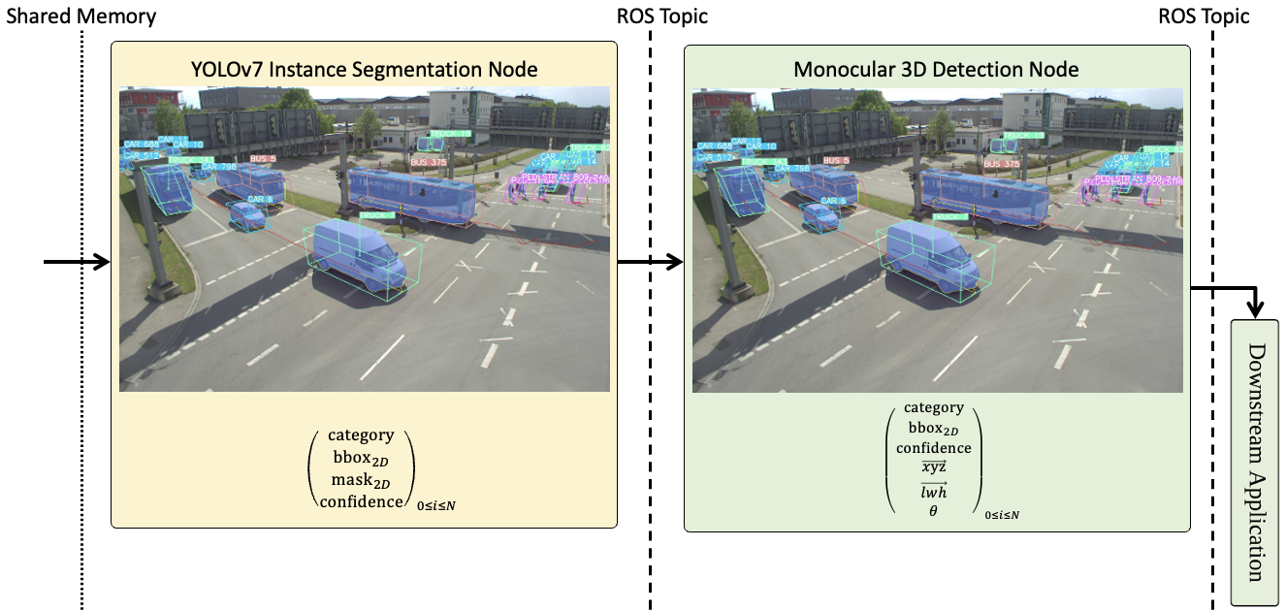
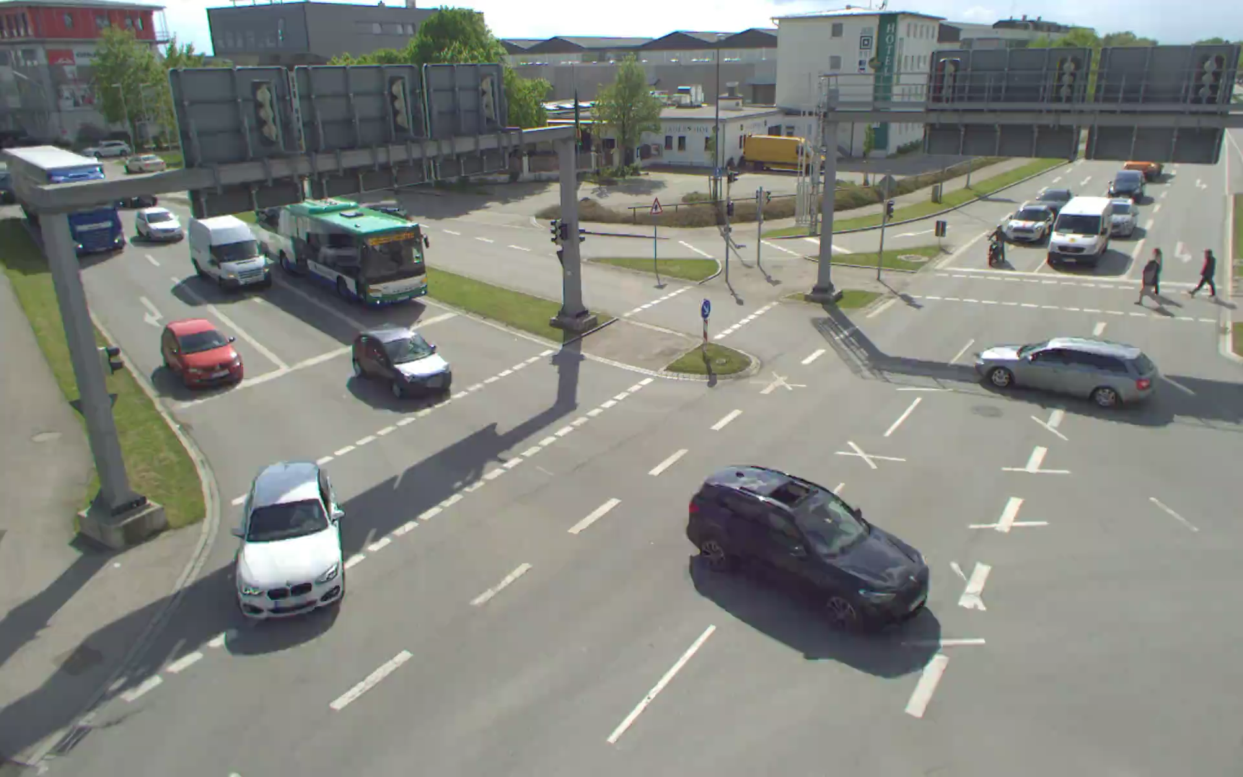
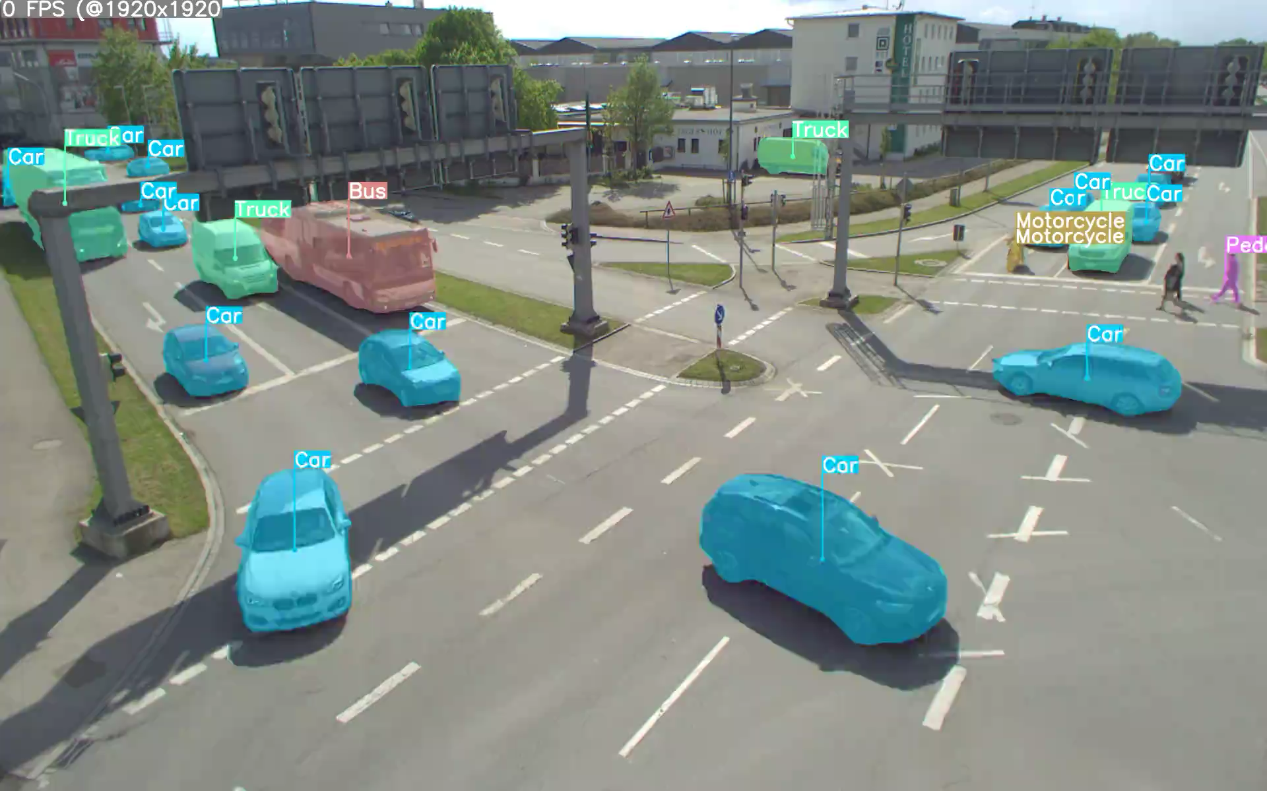
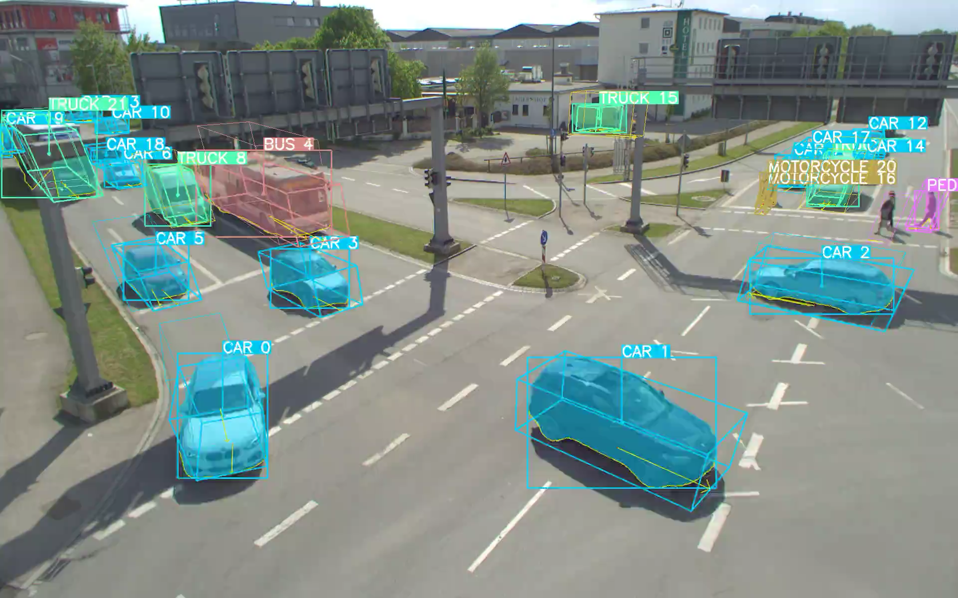

Introduction
Providentia Monocular 3D Object Detection system (Mono3D) [Bir23] generates a 3D digital twin from 2D RGB camera input
Goal:
An enhanced Instance Segmentation Node
$1920×1200$ RGB frames
can detect all 10 classes of TUMTraf Dataset (4 more than previously),
improved detection of large vehicles,
improved detection of small objects far away from the camera
23.02.2024 Monocular Roadside 3D Perception based on Instance Segmentation Bach Ngoc Doan
Notes:
comprehensive global view
reduce accident rates, promote more efficient driving behaviors, etc.
3

Slide 4
Related Work
YOLOv8 [Hag23] : the latest version of YOLO family
Simple architecture, suitable for real-time applications
intuitive command-line interface, well-structured Python package
Instance Segmentation on MS COCO [Lin+14]:
Model | Size (pixels) | mAP^{box} 50-95 | mAP^{mask} 50-95
YOLOv7-seg [WBL23] | 640 | 51.4 | 41.5
YOLOv8x-seg [Hag23] | 640 | 53.4 | 43.4
23.02.2024 Monocular Roadside 3D Perception based on Instance Segmentation Bach Ngoc Doan
Notes:
more significant improvement in mAP as well as speed on our custom dataset.
4

Slide 5
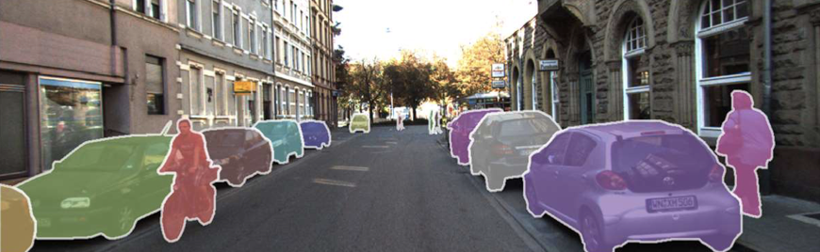
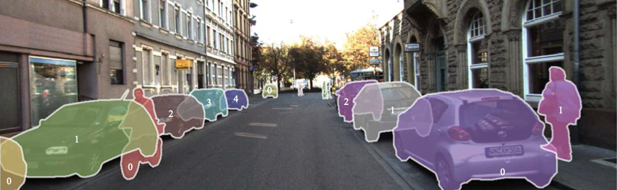
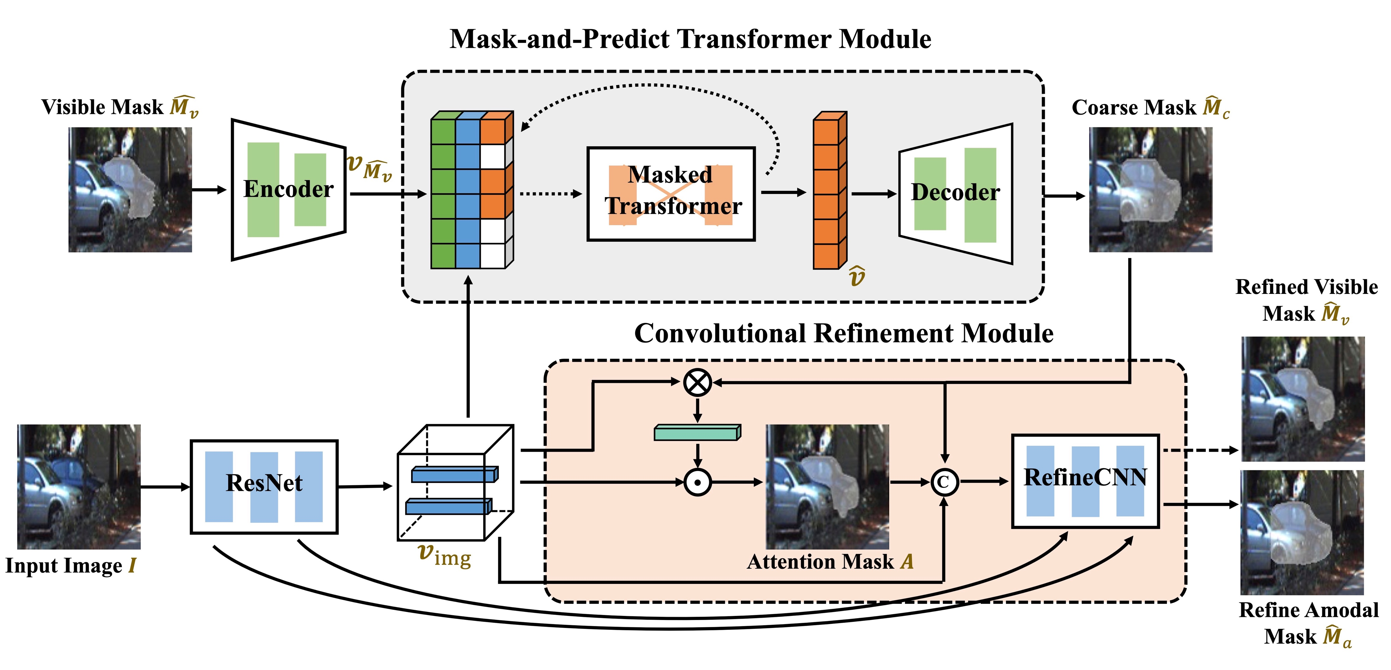
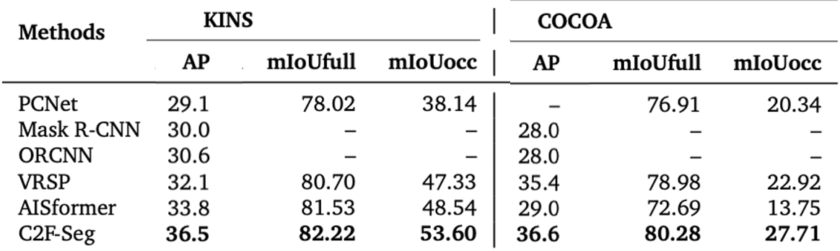
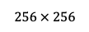
Related Work
(visible) Instance Segmentation → Amodal Instance Segmentation [Qi+19]
Coarse-to-Fine amodal instance segmentation model (C2F-Seg) [Gao+23]
Detect full shape
Beneficial in heavily occluded scenarios
ICCV 2023
Can reuse visible detection from YOLOv8
SOTA
$$256 × 256$$
23.02.2024 Monocular Roadside 3D Perception based on Instance Segmentation Bach Ngoc Doan
Notes:
5

Slide 6
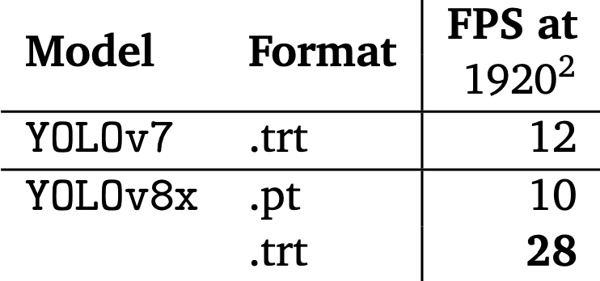
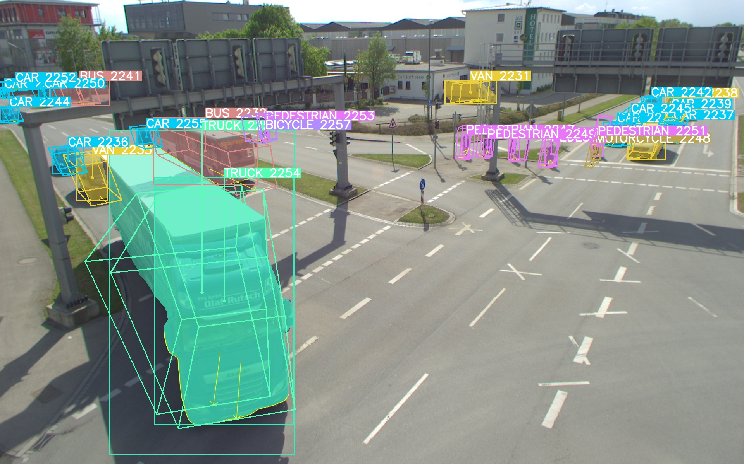
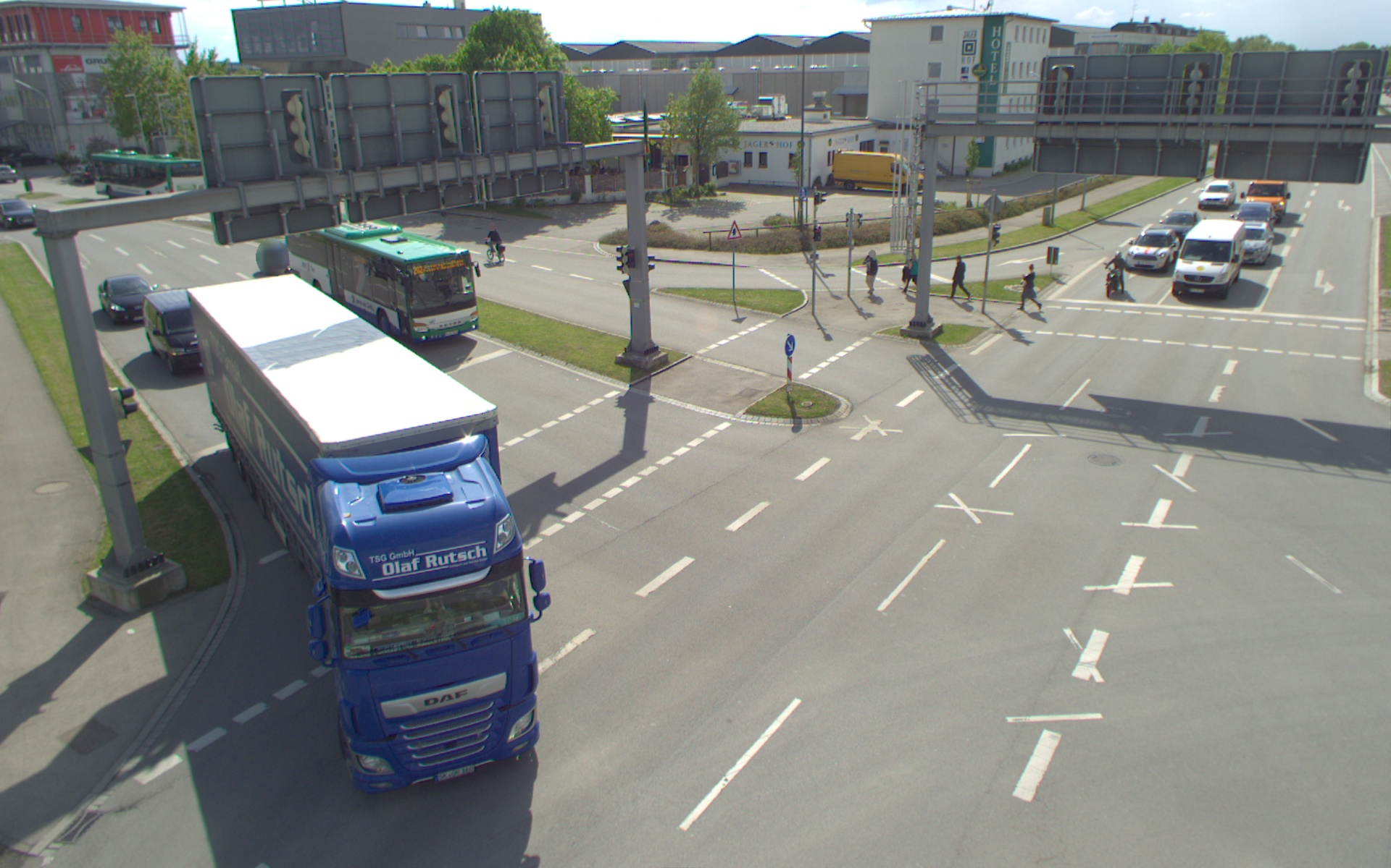

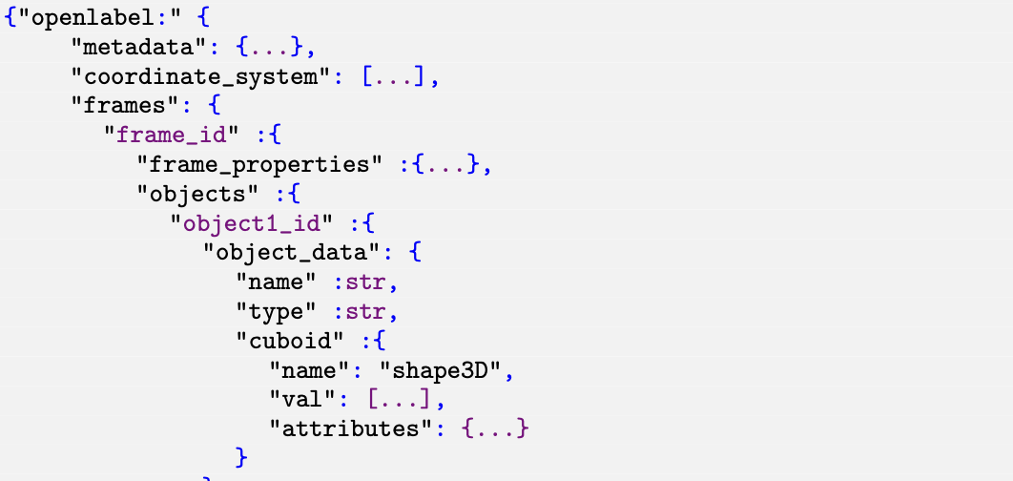
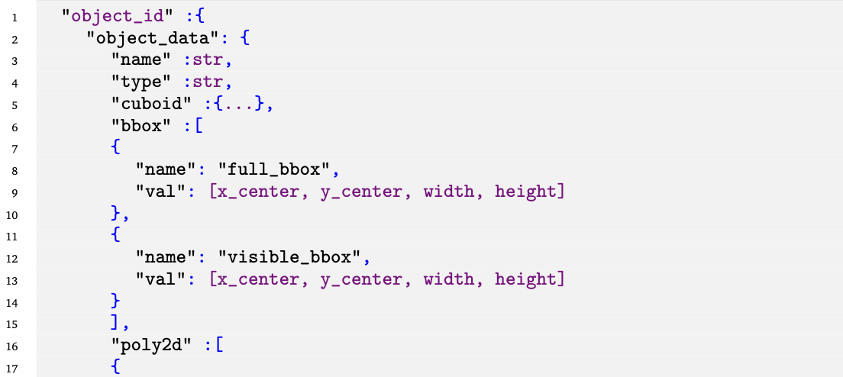
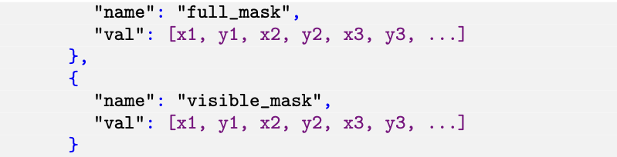
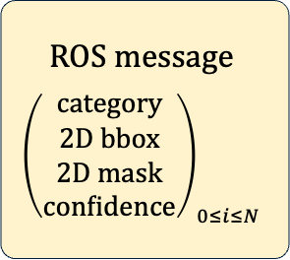
Solution Approach
Instance Segmentation Node
Model weights
. . .
index-to-category mapping
pre_train.pt
tumtraf
pre_train.trt
coco-to-tumtraf
tumtraf.trt
nuImages-to-tumtraf
Downscaling
YOLOv8x-seg
3D Detection Node
Camera Input Image
2D detection results
2D detection results
2D detection results
Visualization (.jpg)
openLABEL (.json)
ROS message
$${\left(\begin{matrix}category \\ 2D bbox \\ 2D mask \\ confidence\end{matrix}\right)}_{0≤i≤N}$$
23.02.2024 Monocular Roadside 3D Perception based on Instance Segmentation Bach Ngoc Doan
Notes:
Training on TUMTraf:
address class mismatches
adapt well to our camera’s perspective
However, before able to train on this TUMTraf ID, we have had to extend the labels with segmentation annotations.
6

Slide 7
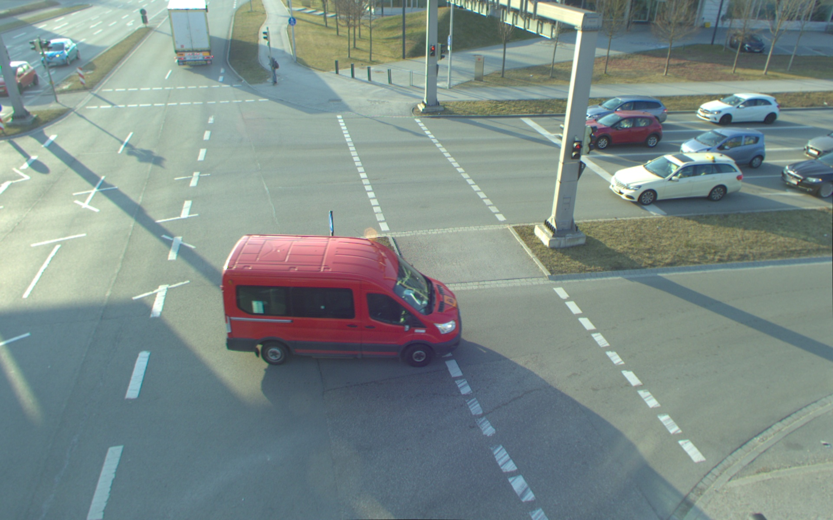
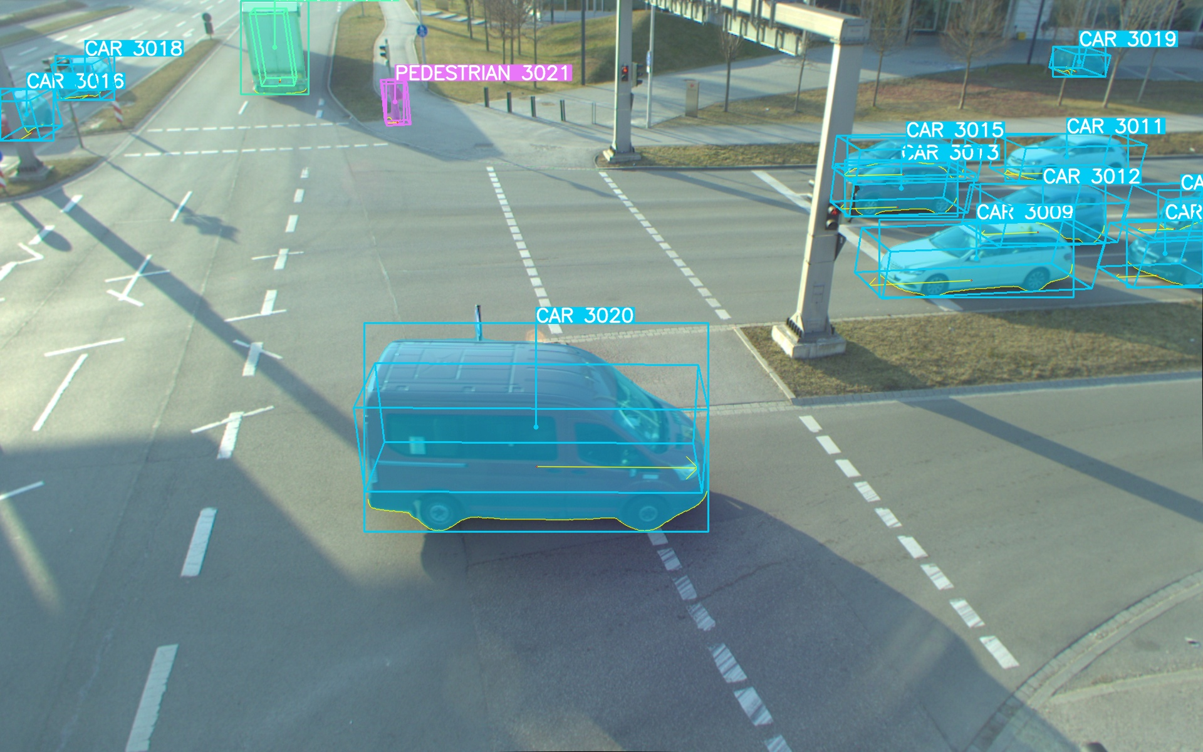
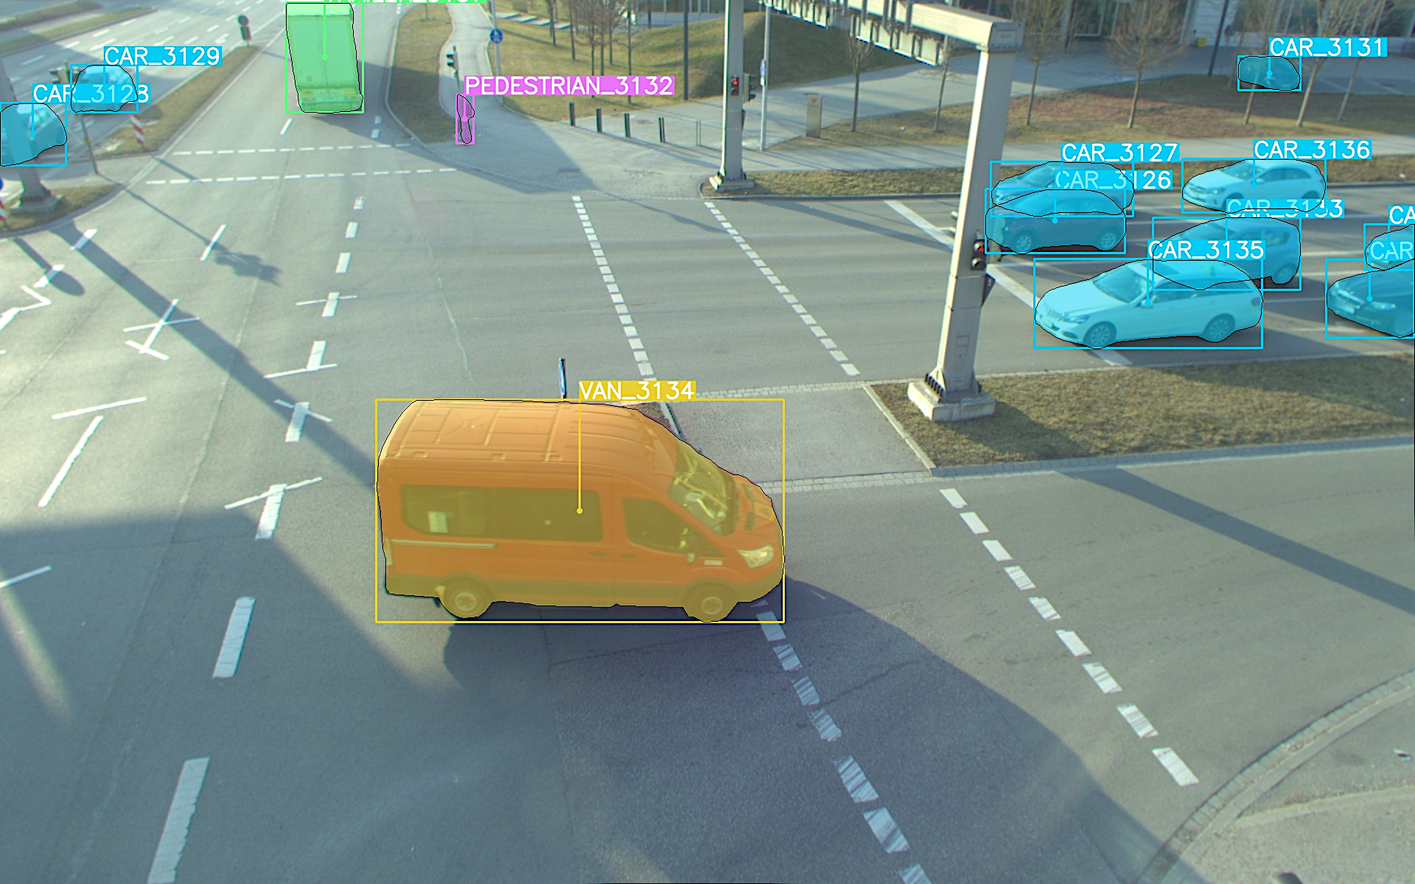
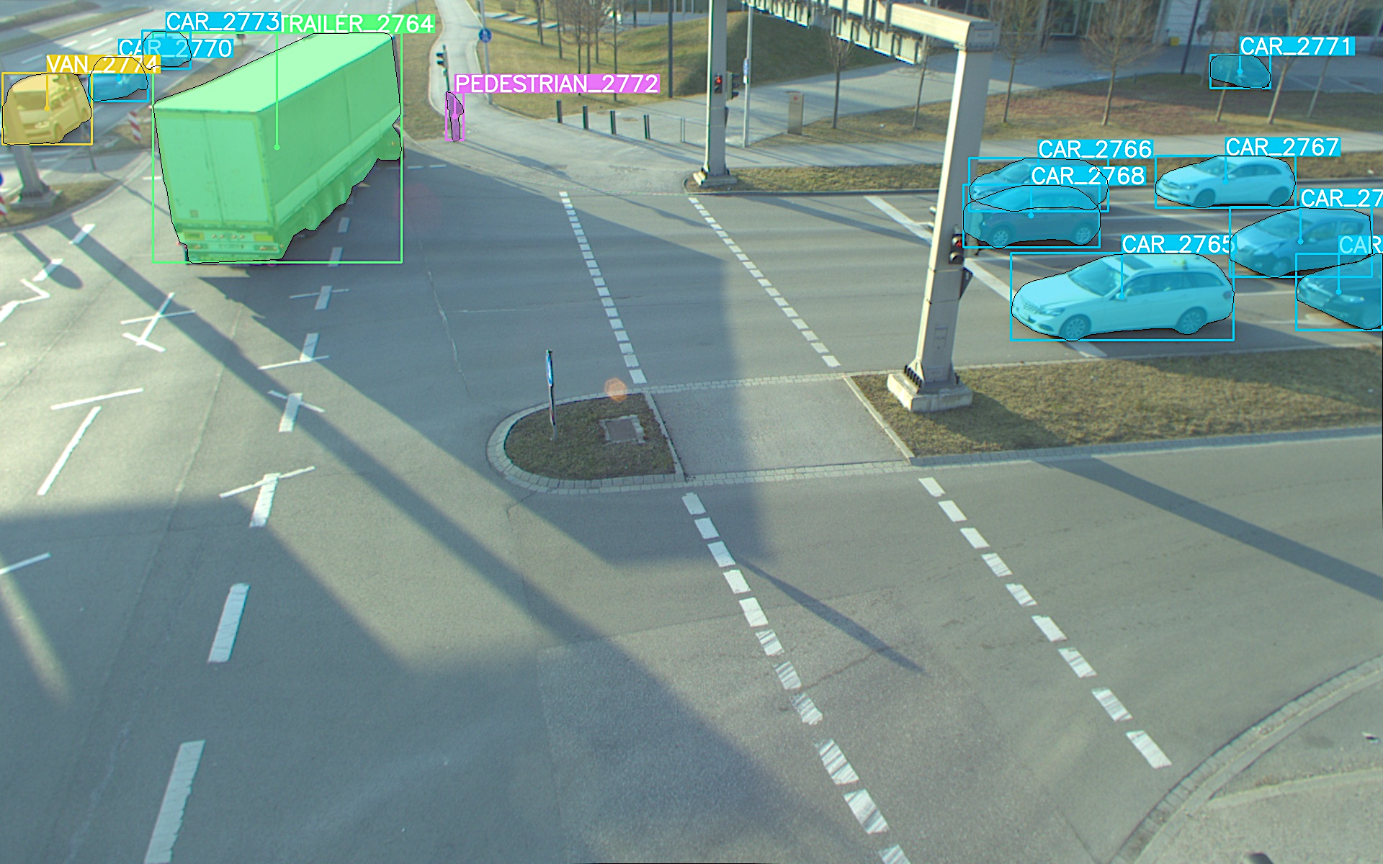
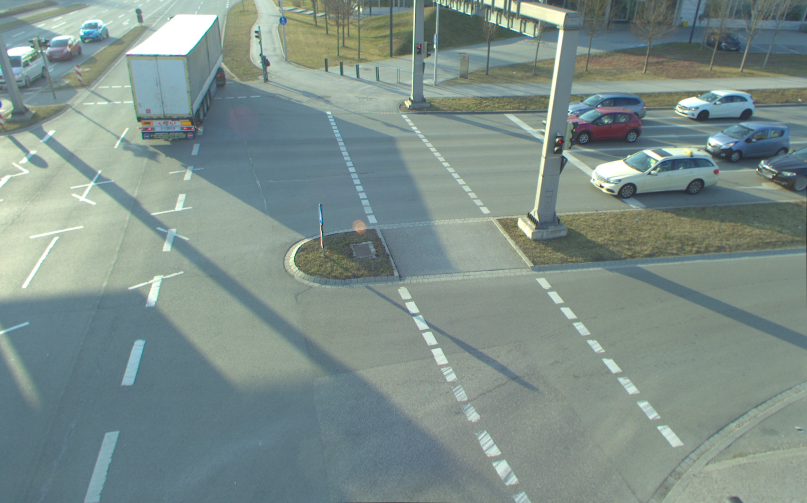
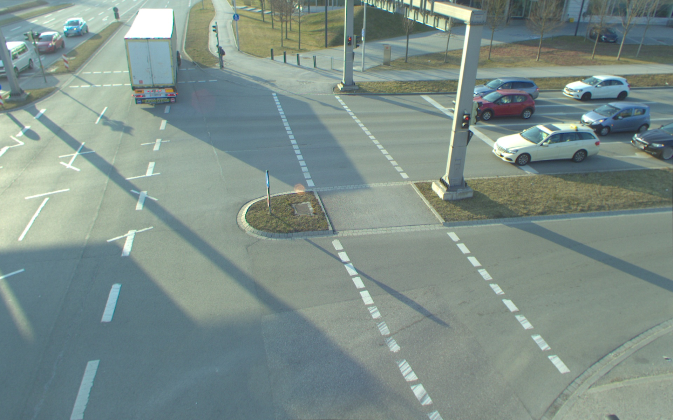
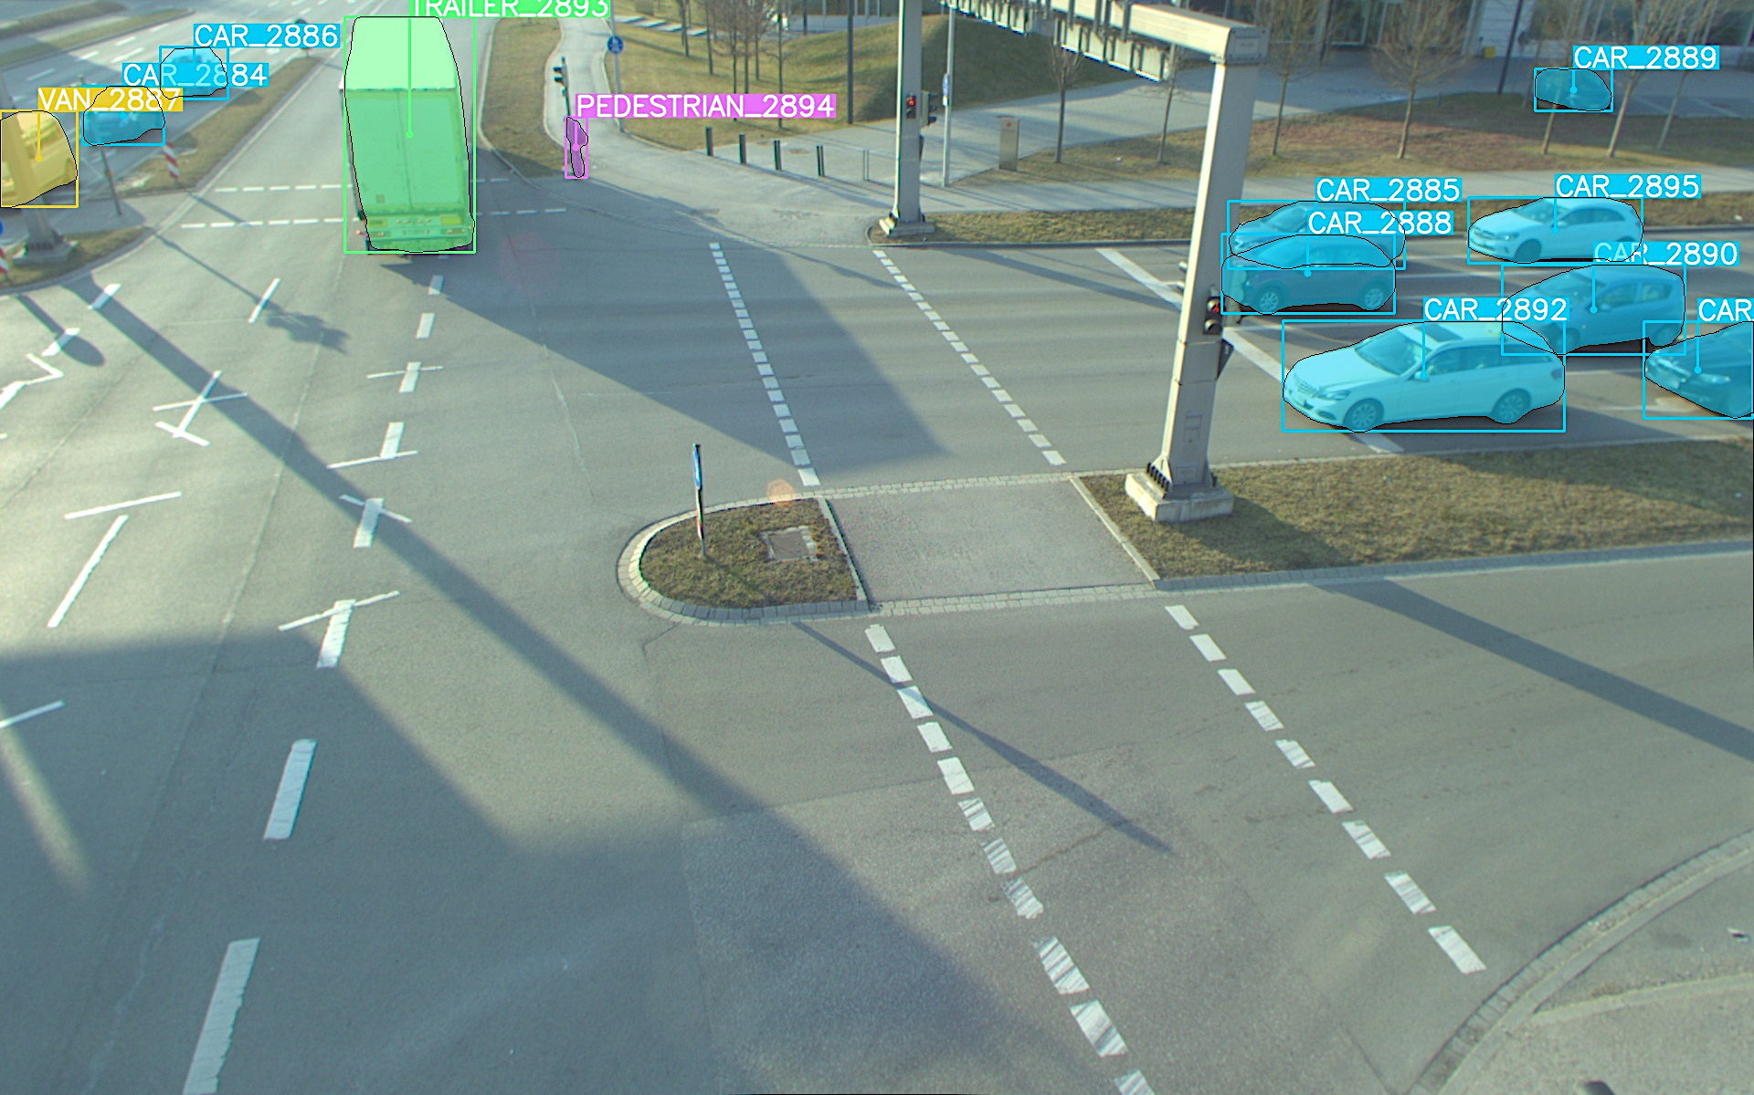
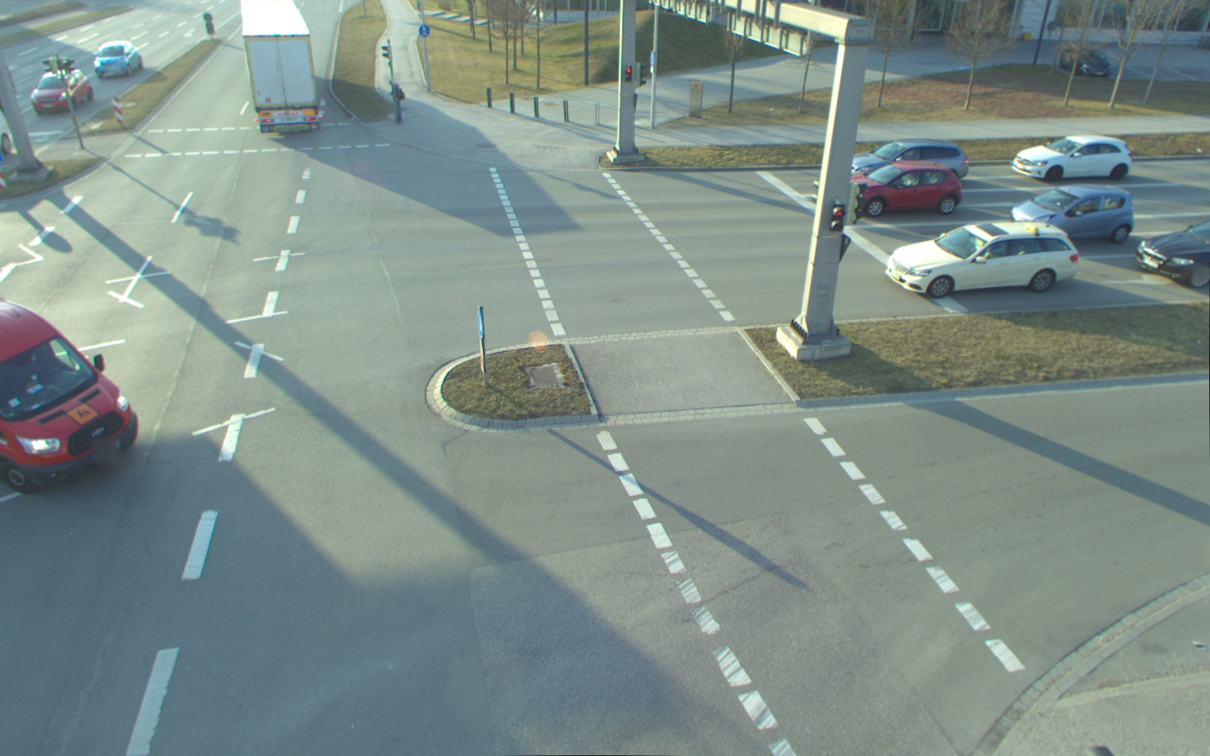
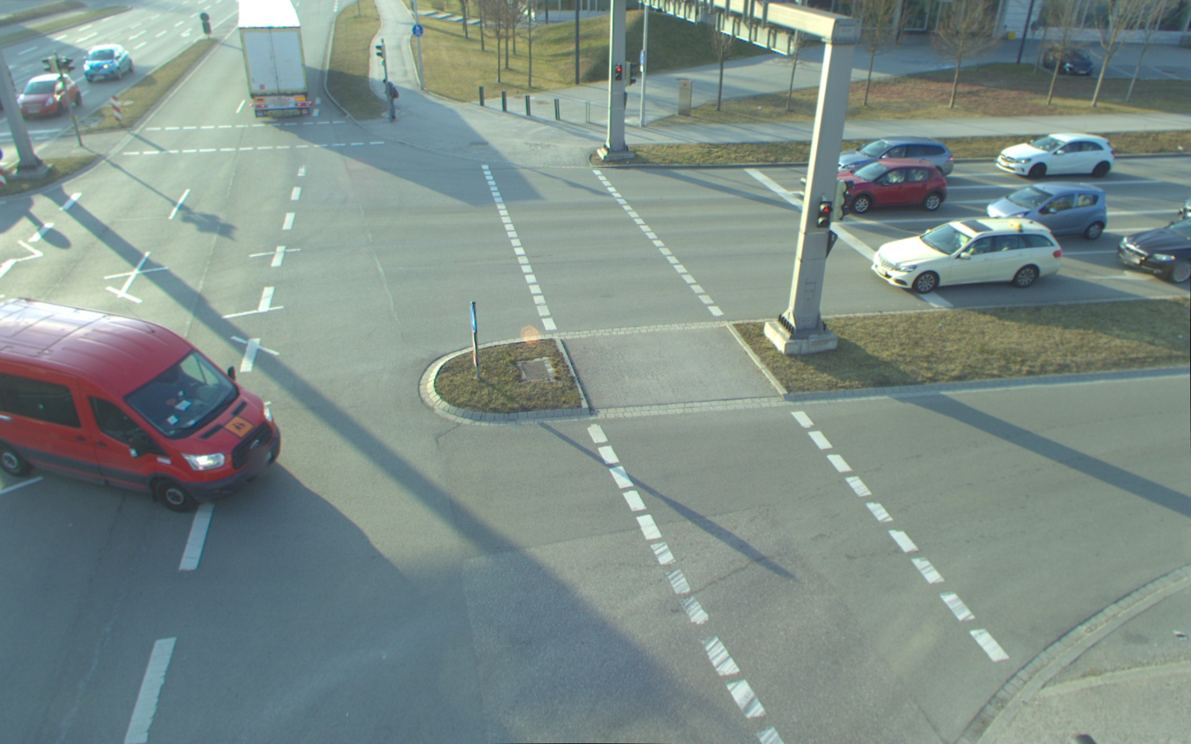
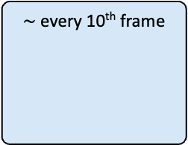
Solution Approach
modal and amodal segmentation annotation for TUMTraf Intersection Dataset
$\sim$ every 10th frame
YOLOv8x-seg
Refinement & Class Adaptation
Image sequence with some annotated frames
. . .
. . .
2D Annotation Interpolation Pipeline
Data Association
Object Mask Interpolation
Calculate bounding box
& copy over attributes
23.02.2024 Monocular Roadside 3D Perception based on Instance Segmentation Bach Ngoc Doan
Notes:
7

Slide 8

Solution Approach
modal and amodal segmentation annotation for TUMTraf Intersection Dataset
$\sim$ every 10th frame
YOLOv8x-seg
Refinement & Class Adaptation
Image sequence with some annotated frames
. . .
. . .
2D Annotation Interpolation Pipeline
Data Association
Object Mask Interpolation
Calculate bounding box
& copy over attributes
23.02.2024 Monocular Roadside 3D Perception based on Instance Segmentation Bach Ngoc Doan
Notes:
8

Slide 9
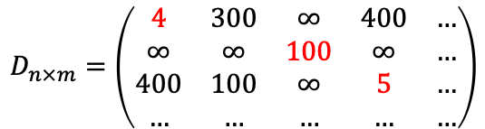
Solution Approach
modal and amodal segmentation annotation for TUMTraf Intersection Dataset
Exploit Jonker-Volgenant algorithm to match object annotation with minimal distance
Data Association
2
2
3
1
1
0
0
$$D_{n×m}=\left(\begin{matrix}4 & 300 & ∞ & 400 & … \\ ∞ & ∞ & 100 & ∞ & … \\ 400 & 100 & ∞ & 5 & … \\ … & … & … & … & …\end{matrix}\right)$$
23.02.2024 Monocular Roadside 3D Perception based on Instance Segmentation Bach Ngoc Doan
Notes:
Distance between objects of different classes is set to infinity.
Example trailer
Additional key words:
scipy.optimize.linear_sum_assignment()
Linear Assignment Problem (LAP)
Data association
9

Slide 10
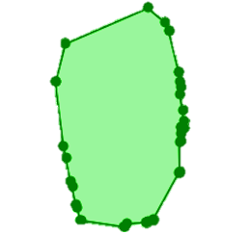
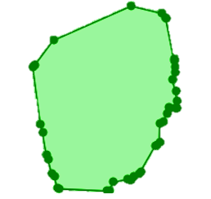
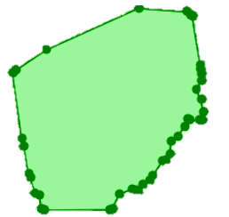
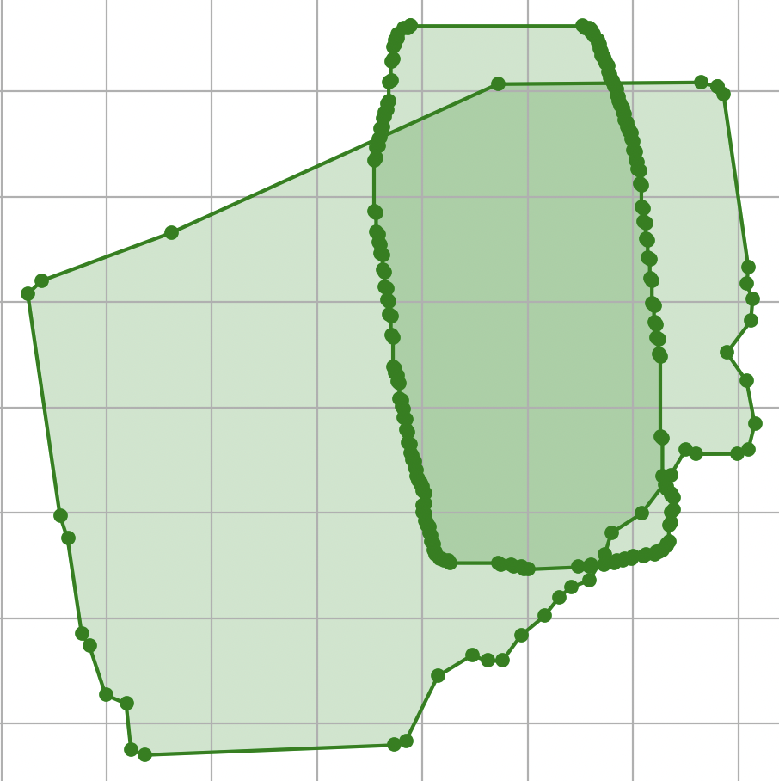
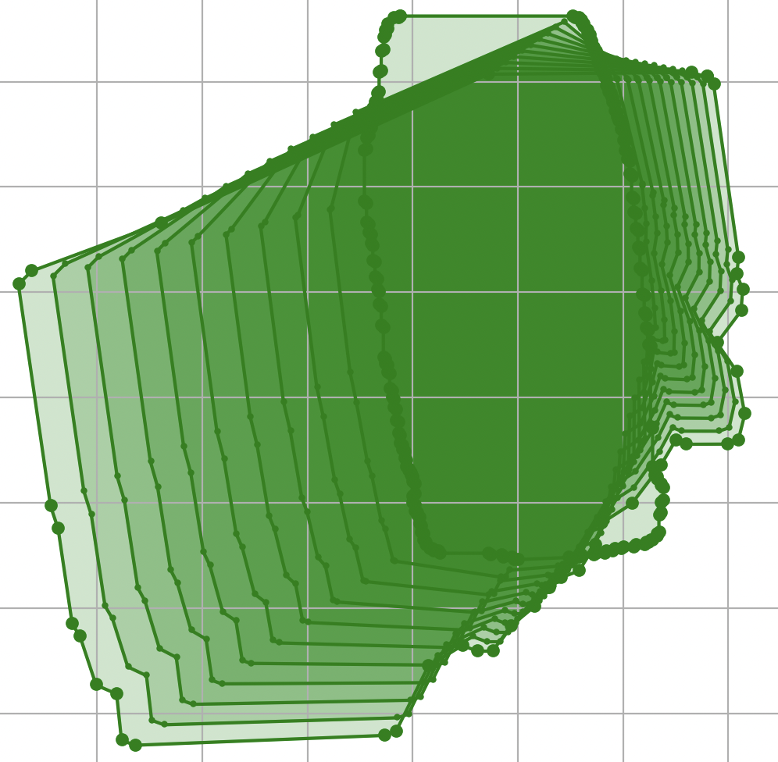
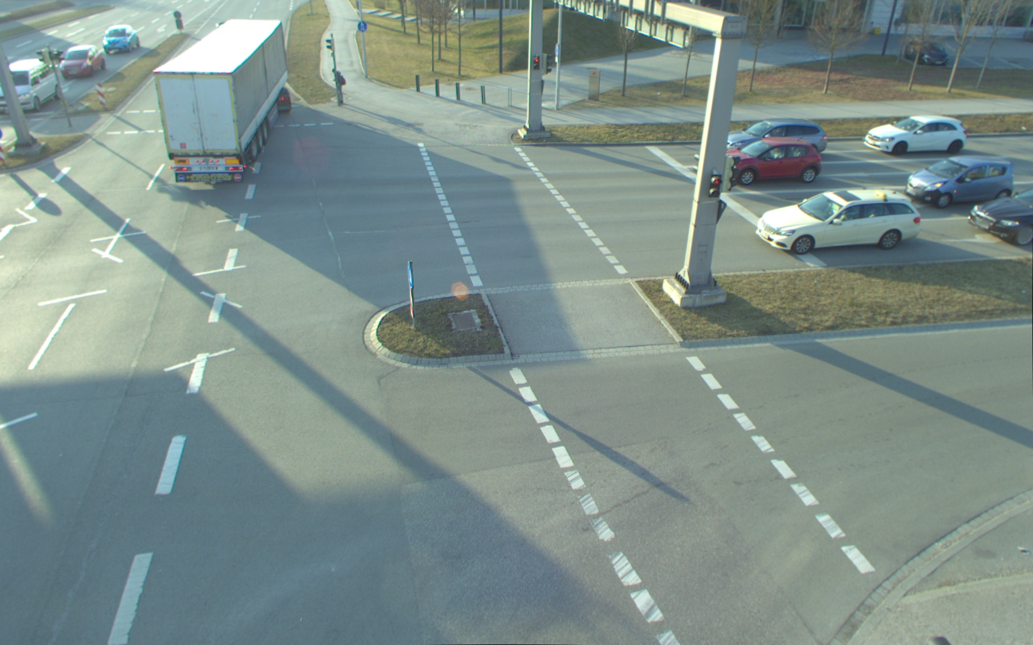
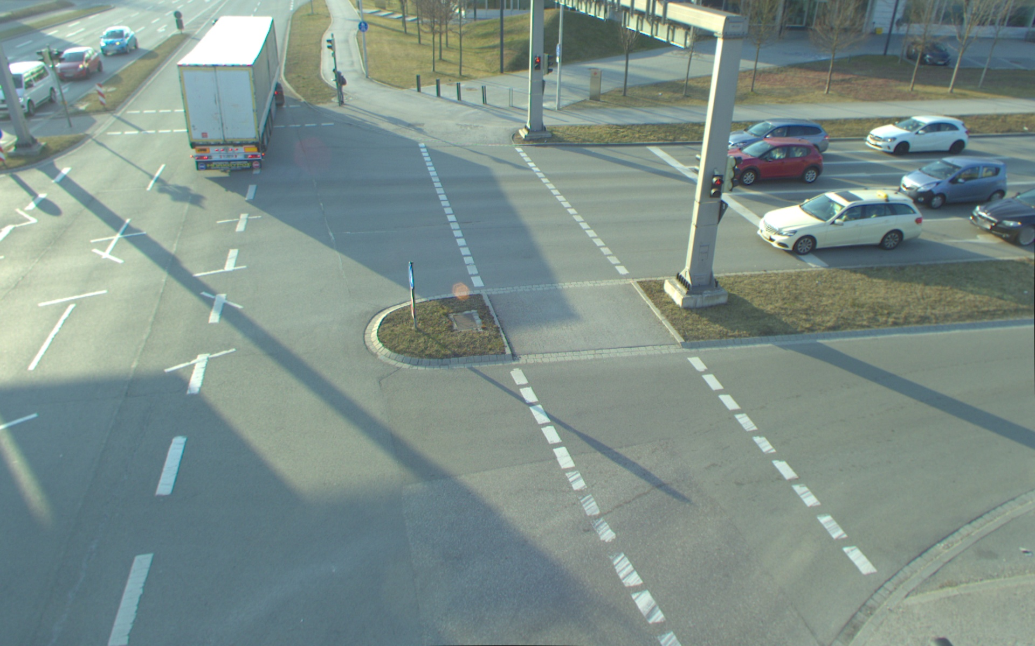
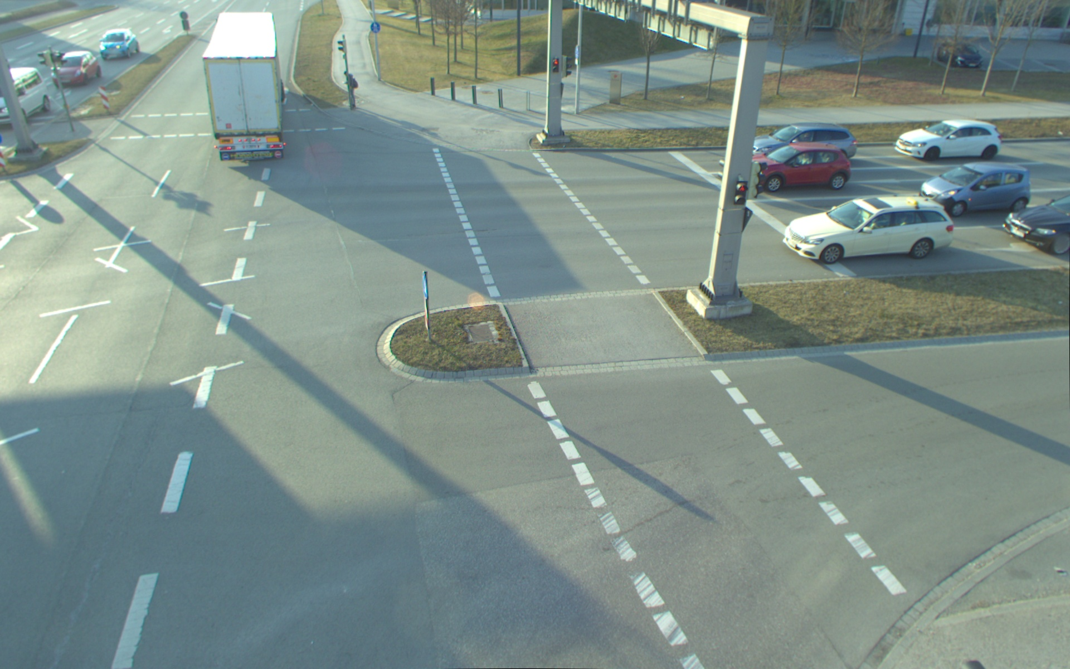
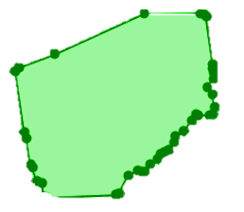
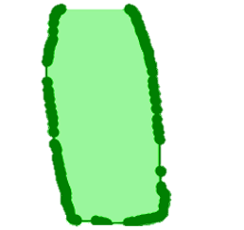
Solution Approach
modal and amodal segmentation annotation for TUMTraf Intersection Dataset
.
Linear interpolation
Interpolate each single polygon point
Object Mask Interpolation
…
…
…
…
23.02.2024 Monocular Roadside 3D Perception based on Instance Segmentation Bach Ngoc Doan
Notes:
Amount of interpolation step := amount of unannotated frames in the middle
10

Slide 11
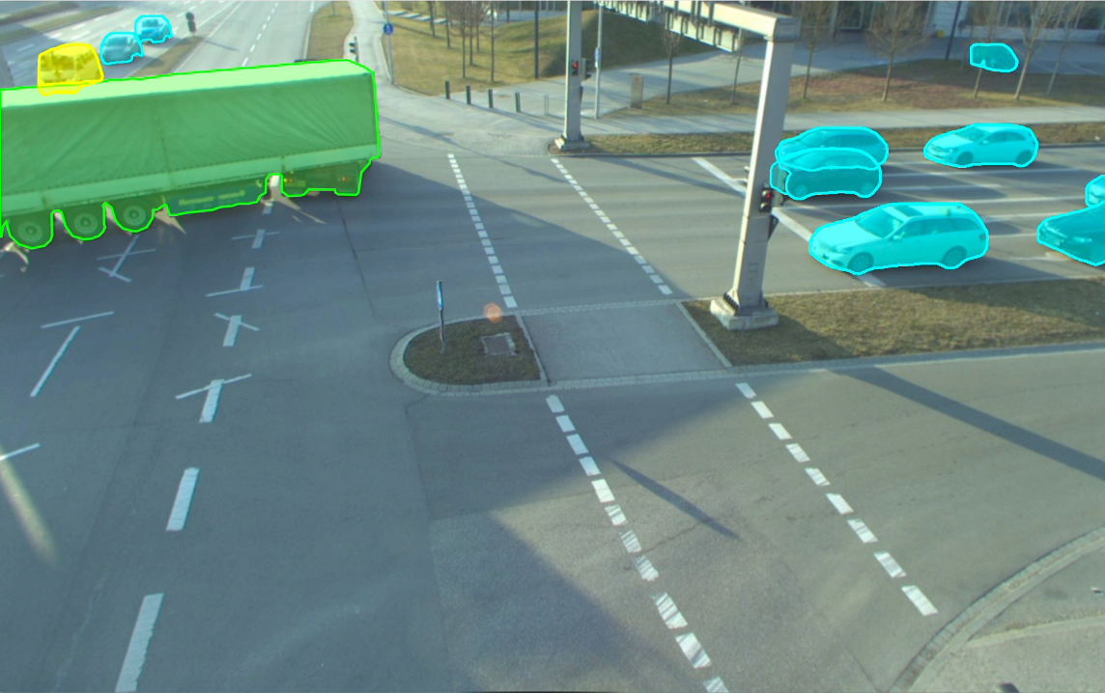
Solution Approach
modal and amodal segmentation annotation for TUMTraf Intersection Dataset
23.02.2024 Monocular Roadside 3D Perception based on Instance Segmentation Bach Ngoc Doan
Notes:
Each point of the polygon contour of the mask is interpolated individually. Therefore, not only the position but also the shape and rotation of the object are interpolated
Possible improvements:
need more robust data association
Use more advanced data association algorithms
Reduce amount of unannotated frames in the middle
The current use of linear interpolation assumes a constant velocity between frames
→ future work: use more advanced interpolation methods
11

Slide 12
Solution Approach
modal and amodal segmentation annotation for TUMTraf Intersection Dataset
OpenLABEL Annotation Formats
Annotated 1238 frames
Train : Val : Test = 1022 : 125 : 91
$\sim$ every 10th frame
YOLOv8x-seg
Refinement & Class Adaptation
Image sequence with some annotated frames
. . .
. . .
2D Annotation Interpolation Pipeline
Object Matching
Object Mask Interpolation
Calculate bounding box
& copy over attributes
Manually Refinement
23.02.2024 Monocular Roadside 3D Perception based on Instance Segmentation Bach Ngoc Doan
Notes:
This data split was used to train segmentation models
12

Slide 13
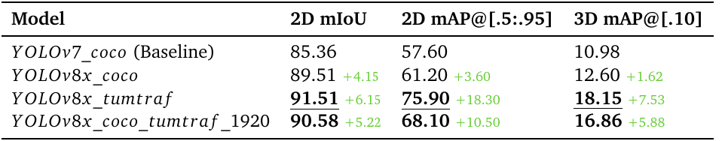
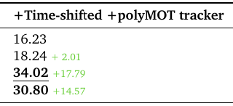
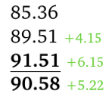
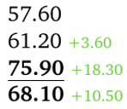
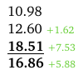
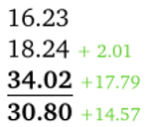
Training and Evaluation
Train the largest variant: YOLOv8x segmentation model
2D instance mask evaluation on the segmentation labels extended test set
3D bounding box evaluation on the TUMTraf Intersection Dataset test set
Time-shifted ground truth labels and 3D tracker
N
Overfitted
23.02.2024 Monocular Roadside 3D Perception based on Instance Segmentation Bach Ngoc Doan
Notes:
performance of 4 models
Training on TUMTraf ID is done with full-image resolution for 250 epochs
YOLOv8 outperforms YOLOv7
Effectiveness of training on TUMTraf
Applying time-shifted LiDAR labels and + poly-MOT 3D tracker → further improved the detection up to 16%
Poly-MOT tracker : Vitus
annotated training set of more than 1K frame is small
data distribution of the test set is also similar to training set
--> Overfitted
13

Slide 14
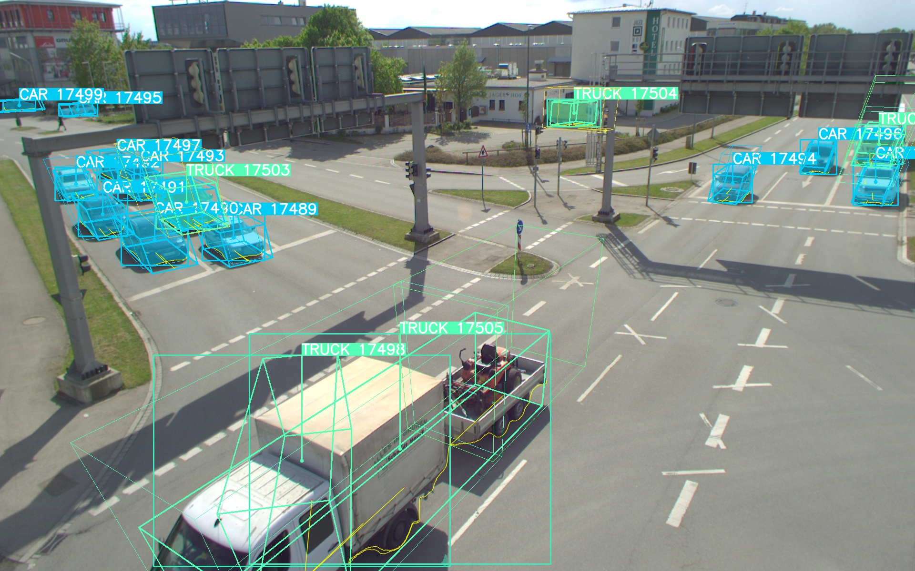
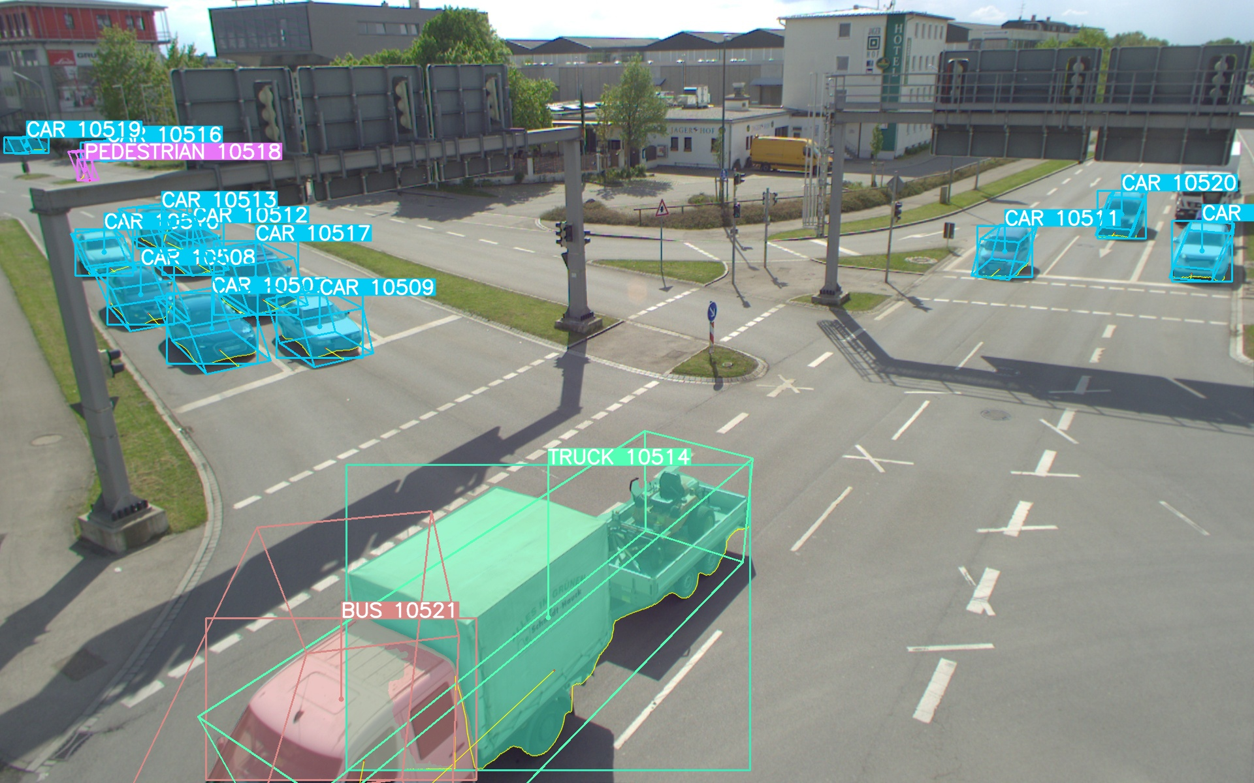
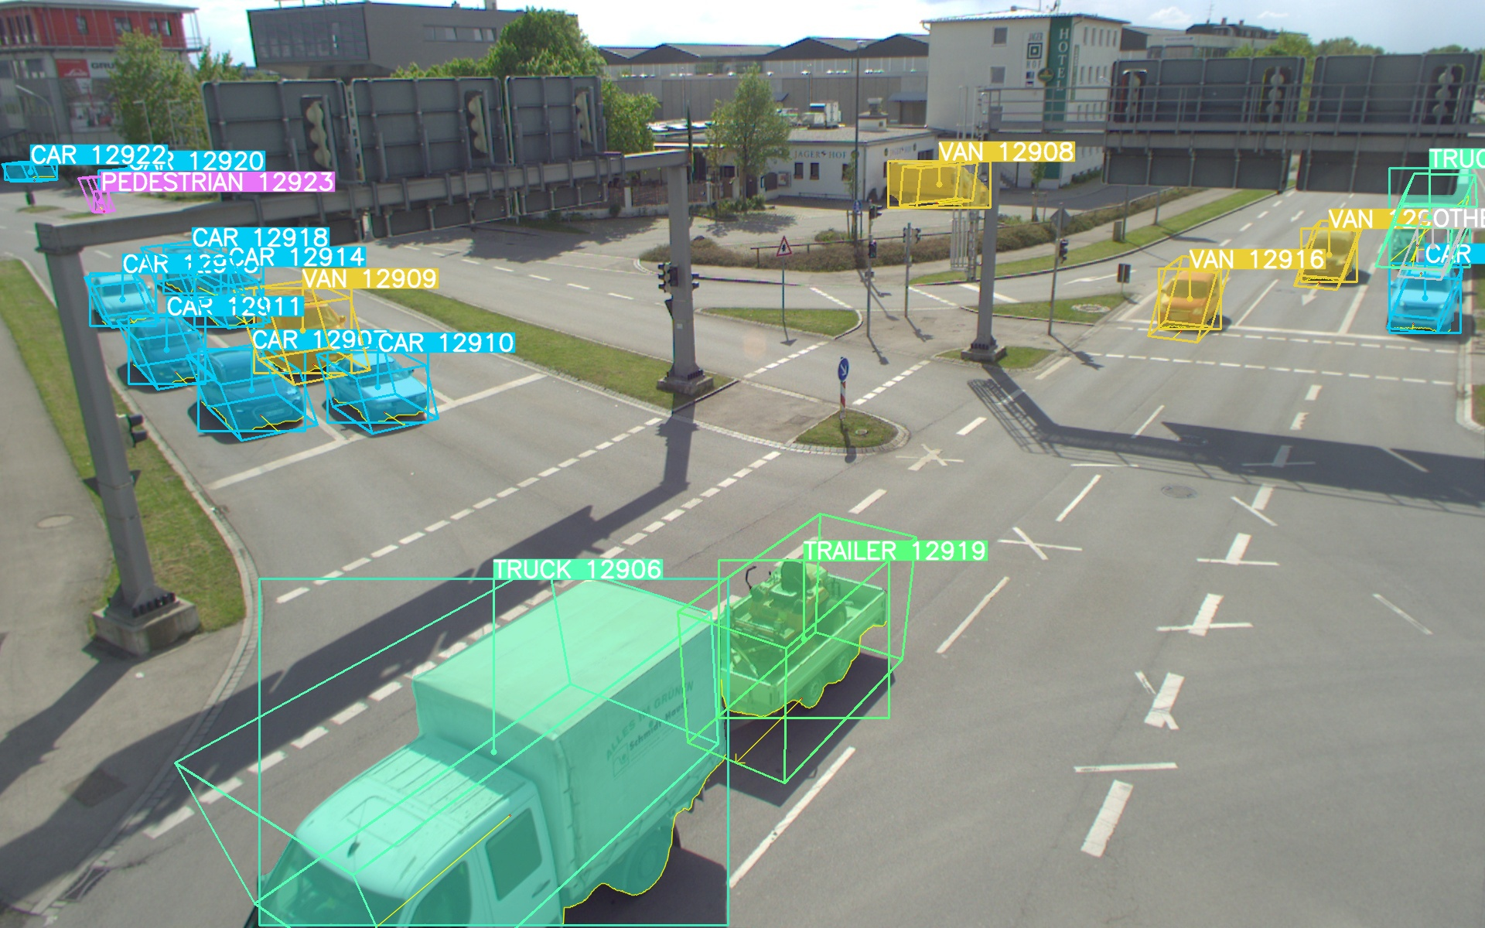
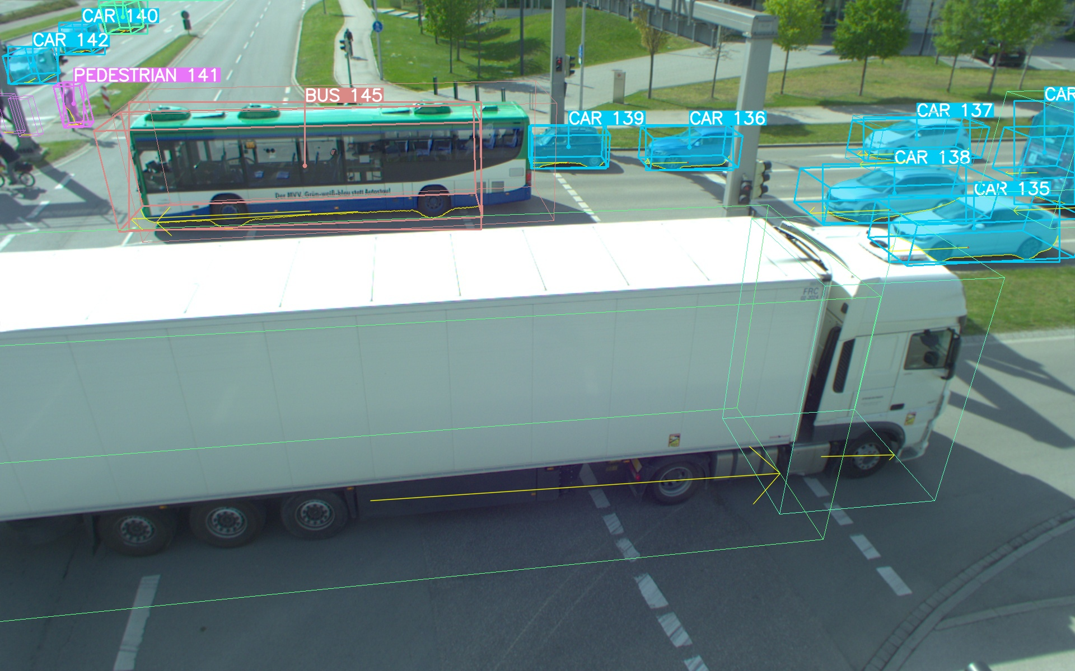
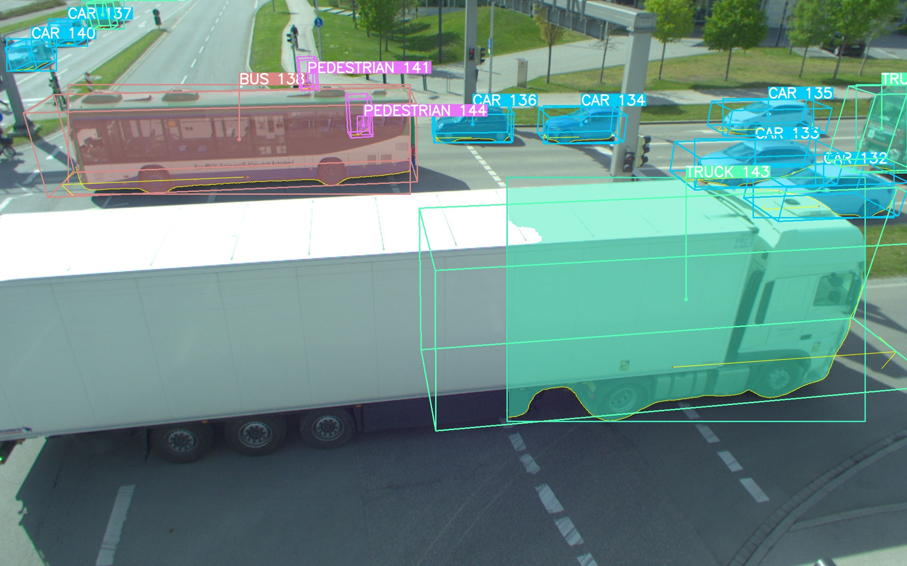




Training and Evaluation
YOLOv8x trained on TUMTraf Intersection Dataset performs best.
Distinction of all 10 classes
Superior performance in detecting large objects
Superior performance in detecting small pedestrians
YOLOv7 trained on COCO
YOLOv8x trained on COCO
YOLOv8x trained on TUMTraf Intersection
23.02.2024 Monocular Roadside 3D Perception based on Instance Segmentation Bach Ngoc Doan
Notes:
Qualitative
additional classes like the yellow vans and the green trailer
detect large objects : require multiple overlapping masks
14

Slide 15






Training and Evaluation
Performance on night sequence of TUMTraf Intersection Dataset
YOLOv7 trained on COCO
YOLOv8x trained on TUMTraf Intersection
23.02.2024 Monocular Roadside 3D Perception based on Instance Segmentation Bach Ngoc Doan
Notes:
very stable prediction
significantly improved the detection of large vehicles
3D mAP is improved by over 10% for this night sequence
15

Slide 16






Training and Evaluation
Performance on the new scenario of highway
YOLOv7 trained on COCO
YOLOv8x trained on TUMTraf Intersection
Overfitted on intersection !
23.02.2024 Monocular Roadside 3D Perception based on Instance Segmentation Bach Ngoc Doan
Notes:
Better detect objects at the front
But worsen in detecting vehicles at the very end
sometimes the detected mask is too large,
sometimes multiple large objects are identified as a single object mask, ex: "TRUCK 103"
To achieve the same performance boost as in intersection sequences, we will have to annotate also the highway sequence and use them for training
However, YOLOv8x_coco still outperforms the currently using YOLOv7_coco
16

Slide 17





Training and Evaluation
Extend visible detections to amodal detections by exploiting C2F-Seg model
2D modal (visible) instance masks predicted by YOLOv8x trained on TUMTraf Intersection Dataset.
Amodal masks from C2F do not yield better performance!
256x256 predictions
lead to unsmooth
object contours
2D amodal masks extended by C2F pre-trained on KINS then fine-tuned on TUMTraf Intersection Dataset.
23.02.2024 Monocular Roadside 3D Perception based on Instance Segmentation Bach Ngoc Doan
Notes:
the final 3D perception performance is worsen due to several reasons
1. unsmooth object contour can affect the 3D lifting stage
2. Intersection Dataset does not exhibit heavy occlusions
Future work:
Adjust C2F architecture to operate with bigger object bbox
Exploit this for more heavily occluded scenario like highway
17

Slide 18

Conclusion
Several key contributions:
2D annotation interpolation pipeline → speeds up annotation process by at least $5$ times
Modal and amodal segmentation annotations for 1238 frames of the TUMTraf Intersection dataset
Examining the effectiveness of pre-training on various datasets and fine-tuning on the annotated frames of the TUMTraf Intersection Dataset.
Best trained model for intersection setting achieves $+18.30\% 2D mAP$ and $+7.53\% 3D mAP@.10$
Integration of the enhanced 2D instance segmentation node into the existing toolchain
23.02.2024 Monocular Roadside 3D Perception based on Instance Segmentation Bach Ngoc Doan
Notes:
In conclusion,
18

Slide 19
Outlook and Future Work
Improve the 2D annotation interpolation pipeline: more accurate data association algorithms, more advanced interpolation techniques, interpolate with smaller interval
Annotate the remaining frames of the Intersection Dataset and other releases of the TUM Traffic Dataset
Train separate models specifically tailored for intersection and highway scenes
Adjust C2F architecture to scale ROI to a larger size and investigate its effectiveness in more heavily occluded scenarios like highways
Exploit 2D multiple-object tracking with the trained YOLOv8 segmentation model
Explore nuImages [Cae+] as pre-train dataset (already trained for 180 epochs)
Thank you for your attention!
23.02.2024 Monocular Roadside 3D Perception based on Instance Segmentation Bach Ngoc Doan
Notes:
Ultralytics has implemented 2D track algorithms, including BoT-SORT and Byte-Track
19

Slide 20
References
[AT16] Arnab, A. and Torr, P. H. “Bottom-up instance segmentation using deep higher- order crfs”. In: arXiv preprint arXiv:1609.02583 (2016).
[Bew+16] Bewley, A., Ge, Z., Ott, L., Ramos, F., and Upcroft, B. “Simple online and re- altime tracking”. In: 2016 IEEE international conference on image processing (ICIP). IEEE. 2016, pp. 3464–3468.
[Bir23] Birkner, J. “Monocular 3D Object Detection Using HD Maps”. 2023.
[Blu22] Blumenthal, L. “Real-Time Monocular 3D Object Detection to Support Au- tonomous Driving”. 2022.
[Cae+20] Caesar, H., Bankiti, V., Lang, A. H., Vora, S., Liong, V. E., Xu, Q., Krishnan, A., Pan, Y., Baldan, G., and Beijbom, O. “nuscenes: A multimodal dataset for autonomous driving”. In: Proceedings of the IEEE/CVF conference on computer vision and pattern recognition. 2020, pp. 11621–11631.
[Cae+] Caesar, H., Bankiti, V., Lang, A. H., Vora, S., Liong, V. E., Xu, Q., Krishnan, A., Pan, Y., Baldan, G., and Beijbom, O. Motional nuImages. URL: https://www. nuscenes.org/nuimages (visited on 01/31/2024).
[CV19] Cai, Z. and Vasconcelos, N. “Cascade R-CNN: High quality object detection and instance segmentation”. In: IEEE transactions on pattern analysis and machine intelligence 43.5 (2019), pp. 1483–1498.
[Che+19a] Chen, K., Pang, J., Wang, J., Xiong, Y., Li, X., Sun, S., Feng, W., Liu, Z., Shi, J., Ouyang, W., et al. “Hybrid task cascade for instance segmentation”. In: Pro- ceedings of the IEEE/CVF conference on computer vision and pattern recognition. 2019, pp. 4974–4983.
[Che+19b] Chen, X., Girshick, R., He, K., and Dollár, P. “Tensormask: A foundation for dense object segmentation”. In: Proceedings of the IEEE/CVF international con- ference on computer vision. 2019, pp. 2061–2069.
[Cor+16] Cordts, M., Omran, M., Ramos, S., Rehfeld, T., Enzweiler, M., Benenson, R., Franke, U., Roth, S., and Schiele, B. “The cityscapes dataset for semantic urban scene understanding”. In: Proceedings of the IEEE conference on computer vision and pattern recognition. 2016, pp. 3213–3223.
23.02.2024 Monocular Roadside 3D Perception based on Instance Segmentation Bach Ngoc Doan
Notes:
20

Slide 21
References
[Cre+22] Creß, C., Zimmer, W., Strand, L., Fortkord, M., Dai, S., Lakshminarasimhan, V., and Knoll, A. “A9-Dataset: Multi-Sensor Infrastructure-Based Dataset for Mobility Research”. In: 2022 IEEE Intelligent Vehicles Symposium (IV). 2022, pp. 965–970. DOI: 10.1109/IV51971.2022.9827401.
[Don+21] Dong, B., Zeng, F., Wang, T., Zhang, X., and Wei, Y. “Solq: Segmenting objects by learning queries”. In: Advances in Neural Information Processing Systems 34 (2021), pp. 21898–21909.
[23] Eclipse eCAL enhanced Communication Abstraction Layer. 2023. URL: https:// eclipse-ecal.github.io/ecal/ (visited on 01/25/2024).
[Fan+21] Fang, Y., Yang, S., Wang, X., Li, Y., Fang, C., Shan, Y., Feng, B., and Liu, W. “Instances as queries”. In: Proceedings of the IEEE/CVF international conference on computer vision. 2021, pp. 6910–6919.
[Fol+19] Follmann, P., König, R., Härtinger, P., Klostermann, M., and Böttger, T. “Learning to see the invisible: End-to-end trainable amodal instance segmentation”. In: 2019 IEEE Winter Conference on Applications of Computer Vision (WACV). IEEE. 2019, pp. 1328–1336.
[Gao+23] Gao, J., Qian, X., Wang, Y., Xiao, T., He, T., Zhang, Z., and Fu, Y. “Coarse-to- fine amodal segmentation with shape prior”. In: Proceedings of the IEEE/CVF International Conference on Computer Vision. 2023, pp. 1262–1271.
[GLU12] Geiger, A., Lenz, P., and Urtasun, R. “Are we ready for autonomous driving? the kitti vision benchmark suite”. In: 2012 IEEE conference on computer vision and pattern recognition. IEEE. 2012, pp. 3354–3361.
[GBK22] Gu, W., Bai, S., and Kong, L. “A review on 2D instance segmentation based on deep neural networks”. In: Image and Vision Computing 120 (2022), p. 104401.
[Hag14] Hagedorn, N. COCO Data Format. 2014. URL: https://cocodataset.org/#format-data (visited on 01/21/2024).
[Hag20] Hagedorn, N. ASAM OpenLABEL Concept Paper. 2020. URL: https://www.asam.net/index.php?eID=dumpFile&t=f&f=3876&token=413e8c85031ae64cc35cf42d0768627514868b2f#_introduction (visited on 01/17/2024).
[Hag23] Hagedorn, N. Ultralytics Ultralytics YOLOv8 Docs. 2023. URL: https://docs.ultralytics.com (visited on 01/18/2024).
23.02.2024 Monocular Roadside 3D Perception based on Instance Segmentation Bach Ngoc Doan
Notes:
21

Slide 22
References
[Har+14] Hariharan, B., Arbeláez, P., Girshick, R., and Malik, J. “Simultaneous detection and segmentation”. In: Computer Vision–ECCV 2014: 13th European Conference, Zurich, Switzerland, September 6-12, 2014, Proceedings, Part VII 13. Springer. 2014, pp. 297–312.
[He+17a] He, K., Gkioxari, G., Dollár, P., and Girshick, R. “Mask r-cnn”. In: Proceedings of the IEEE international conference on computer vision. 2017, pp. 2961–2969.
[He+17b] He, K., Gkioxari, G., Dollár, P., and Girshick, R. “Mask r-cnn”. In: Proceedings of the IEEE international conference on computer vision. 2017, pp. 2961–2969.
[Hu+21] Hu, J., Cao, L., Lu, Y., Zhang, S., Wang, Y., Li, K., Huang, F., Shao, L., and Ji, R. “Istr: End-to-end instance segmentation with transformers”. In: arXiv preprint arXiv:2105.00637 (2021).
[JV88] Jonker, R. and Volgenant, T. “A shortest augmenting path algorithm for dense and sparse linear assignment problems”. In: DGOR/NSOR: Papers of the 16th Annual Meeting of DGOR in Cooperation with NSOR/Vorträge der 16. Jahresta- gung der DGOR zusammen mit der NSOR. Springer. 1988, pp. 622–622.
[KTT23] Ke, L., Tai, Y.-W., and Tang, C.-K. “Occlusion-Aware Instance Segmentation Via BiLayer Network Architectures”. In: IEEE Transactions on Pattern Analysis and Machine Intelligence (2023).
[LP20] Lee, Y. and Park, J. “Centermask: Real-time anchor-free instance segmentation”. In: Proceedings of the IEEE/CVF conference on computer vision and pattern recog- nition. 2020, pp. 13906–13915.
[Li+23] Li, X., Xie, T., Liu, D., Gao, J., Dai, K., Jiang, Z., Zhao, L., and Wang, K. “Poly- mot: A polyhedral framework for 3d multi-object tracking”. In: 2023 IEEE/RSJ International Conference on Intelligent Robots and Systems (IROS). IEEE. 2023, pp. 9391–9398.
[Lin+14] Lin, T.-Y., Maire, M., Belongie, S., Hays, J., Perona, P., Ramanan, D., Dollár, P., and Zitnick, C. L. “Microsoft coco: Common objects in context”. In: Computer Vision–ECCV 2014: 13th European Conference, Zurich, Switzerland, September 6-12, 2014, Proceedings, Part V 13. Springer. 2014, pp. 740–755.
23.02.2024 Monocular Roadside 3D Perception based on Instance Segmentation Bach Ngoc Doan
Notes:
22

Slide 23
References
[Lv+23] Lv, W., Xu, S., Zhao, Y., Wang, G., Wei, J., Cui, C., Du, Y., Dang, Q., and Liu, Y. “Detrs beat yolos on real-time object detection”. In: arXiv preprint arXiv:2304.08069 (2023).
[NHD17] Newell, A., Huang, Z., and Deng, J. “Associative embedding: End-to-end learn- ing for joint detection and grouping”. In: Advances in neural information pro- cessing systems 30 (2017).
[Qi+19] Qi, L., Jiang, L., Liu, S., Shen, X., and Jia, J. “Amodal instance segmentation with kins dataset”. In: Proceedings of the IEEE/CVF Conference on Computer Vi- sion and Pattern Recognition. 2019, pp. 3014–3023.
[Qui+09] Quigley, M., Conley, K., Gerkey, B., Faust, J., Foote, T., Leibs, J., Wheeler, R., Ng, A. Y., et al. “ROS: an open-source Robot Operating System”. In: ICRA workshop on open source software. Vol. 3. 3.2. Kobe, Japan. 2009, p. 5.
[Red+16] Redmon, J., Divvala, S., Girshick, R., and Farhadi, A. “You only look once: Uni- fied, real-time object detection”. In: Proceedings of the IEEE conference on com- puter vision and pattern recognition. 2016, pp. 779–788.
[RF18] Redmon, J. and Farhadi, A. “Yolov3: An incremental improvement”. In: arXiv preprint arXiv:1804.02767 (2018).
[RZ17] Ren, M. and Zemel, R. S. “End-to-end instance segmentation with recurrent attention”. In: Proceedings of the IEEE conference on computer vision and pattern recognition. 2017, pp. 6656–6664.
[RT16] Romera-Paredes, B. and Torr, P. H. S. “Recurrent instance segmentation”. In: Computer Vision–ECCV 2016: 14th European Conference, Amsterdam, The Netherlands, October 11-14, 2016, Proceedings, Part VI 14. Springer. 2016, pp. 312–329.
[Sal+17] Salvador, A., Bellver, M., Campos, V., Baradad, M., Marques, F., Torres, J., and Giro-i-Nieto, X. “Recurrent neural networks for semantic instance segmenta- tion”. In: arXiv preprint arXiv:1712.00617 (2017).
[SMZ19] Sekachev, B., Manovich, N., and Zhavoronkov, A. “Computer vision annotation tool: a universal approach to data annotation”. In: Intel [Internet] 1 (2019).
23.02.2024 Monocular Roadside 3D Perception based on Instance Segmentation Bach Ngoc Doan
Notes:
23

Slide 24
References
[Sun+20] Sun, P., Kretzschmar, H., Dotiwalla, X., Chouard, A., Patnaik, V., Tsui, P., Guo, J., Zhou, Y., Chai, Y., Caine, B., et al. “Scalability in perception for autonomous driving: Waymo open dataset”. In: Proceedings of the IEEE/CVF conference on computer vision and pattern recognition. 2020, pp. 2446–2454.
[Tan+21] Tan, J., Wang, K., Chen, L., Zhang, G., Li, J., and Zhang, X. “HCFS3D: Hierar- chical coupled feature selection network for 3D semantic and instance segmen- tation”. In: Image and Vision Computing 109 (2021), p. 104129.
[Tra+22] Tran, M., Vo, K., Yamazaki, K., Fernandes, A., Kidd, M., and Le, N. “AIS- Former: Amodal Instance Segmentation with Transformer”. In: arXiv preprint arXiv:2210.06323 (2022).
[Van16] Vanholder, H. “Efficient inference with tensorrt”. In: GPU Technology Conference. Vol. 1. 2. 2016.
[WBL23] Wang, C.-Y., Bochkovskiy, A., and Liao, H.-Y. M. “YOLOv7: Trainable bag-of- freebies sets new state-of-the-art for real-time object detectors”. In: Proceedings of the IEEE/CVF Conference on Computer Vision and Pattern Recognition. 2023, pp. 7464–7475.
[Wan+22] Wang, Y., Ahsan, U., Li, H., Hagen, M., et al. “A comprehensive review of mod- ern object segmentation approaches”. In: Foundations and Trends® in Computer Graphics and Vision 13.2-3 (2022), pp. 111–283.
[Xia+21] Xiao, Y., Xu, Y., Zhong, Z., Luo, W., Li, J., and Gao, S. “Amodal segmentation based on visible region segmentation and shape prior”. In: Proceedings of the AAAI Conference on Artificial Intelligence. Vol. 35. 4. 2021, pp. 2995–3003.
[Xie+20] Xie, E., Sun, P., Song, X., Wang, W., Liu, X., Liang, D., Shen, C., and Luo, P. “Polarmask: Single shot instance segmentation with polar representation”. In: Proceedings of the IEEE/CVF conference on computer vision and pattern recogni- tion. 2020, pp. 12193–12202.
[Yao+22] Yao, J., Hong, Y., Wang, C., Xiao, T., He, T., Locatello, F., Wipf, D. P., Fu, Y., and Zhang, Z. “Self-supervised Amodal Video Object Segmentation”. In: Advances in Neural Information Processing Systems 35 (2022), pp. 6278–6291.
[Zha+20] Zhan, X., Pan, X., Dai, B., Liu, Z., Lin, D., and Loy, C. C. “Self-supervised scene de-occlusion”. In: Proceedings of the IEEE/CVF conference on computer vision and pattern recognition. 2020, pp. 3784–3792.
23.02.2024 Monocular Roadside 3D Perception based on Instance Segmentation Bach Ngoc Doan
Notes:
24

Slide 25
References
[Zha+17] Zhang, X., Xu, W., Dong, C., and Dolan, J. M. “Efficient L-shape fitting for vehi- cle detection using laser scanners”. In: 2017 IEEE Intelligent Vehicles Symposium (IV). IEEE. 2017, pp. 54–59.
[Zhu+17] Zhu, Y., Tian, Y., Metaxas, D., and Dollár, P. “Semantic amodal segmentation”. In: Proceedings of the IEEE conference on computer vision and pattern recognition. 2017, pp. 1464–1472.
[Zim+23] Zimmer, W., Creß, C., Nguyen, H. T., and Knoll, A. C. “A9 Intersection Dataset: All You Need for Urban 3D Camera-LiDAR Roadside Perception”. In: arXiv preprint arXiv:2306.09266 (2023).
23.02.2024 Monocular Roadside 3D Perception based on Instance Segmentation Bach Ngoc Doan
Notes:
25

